Slide 1
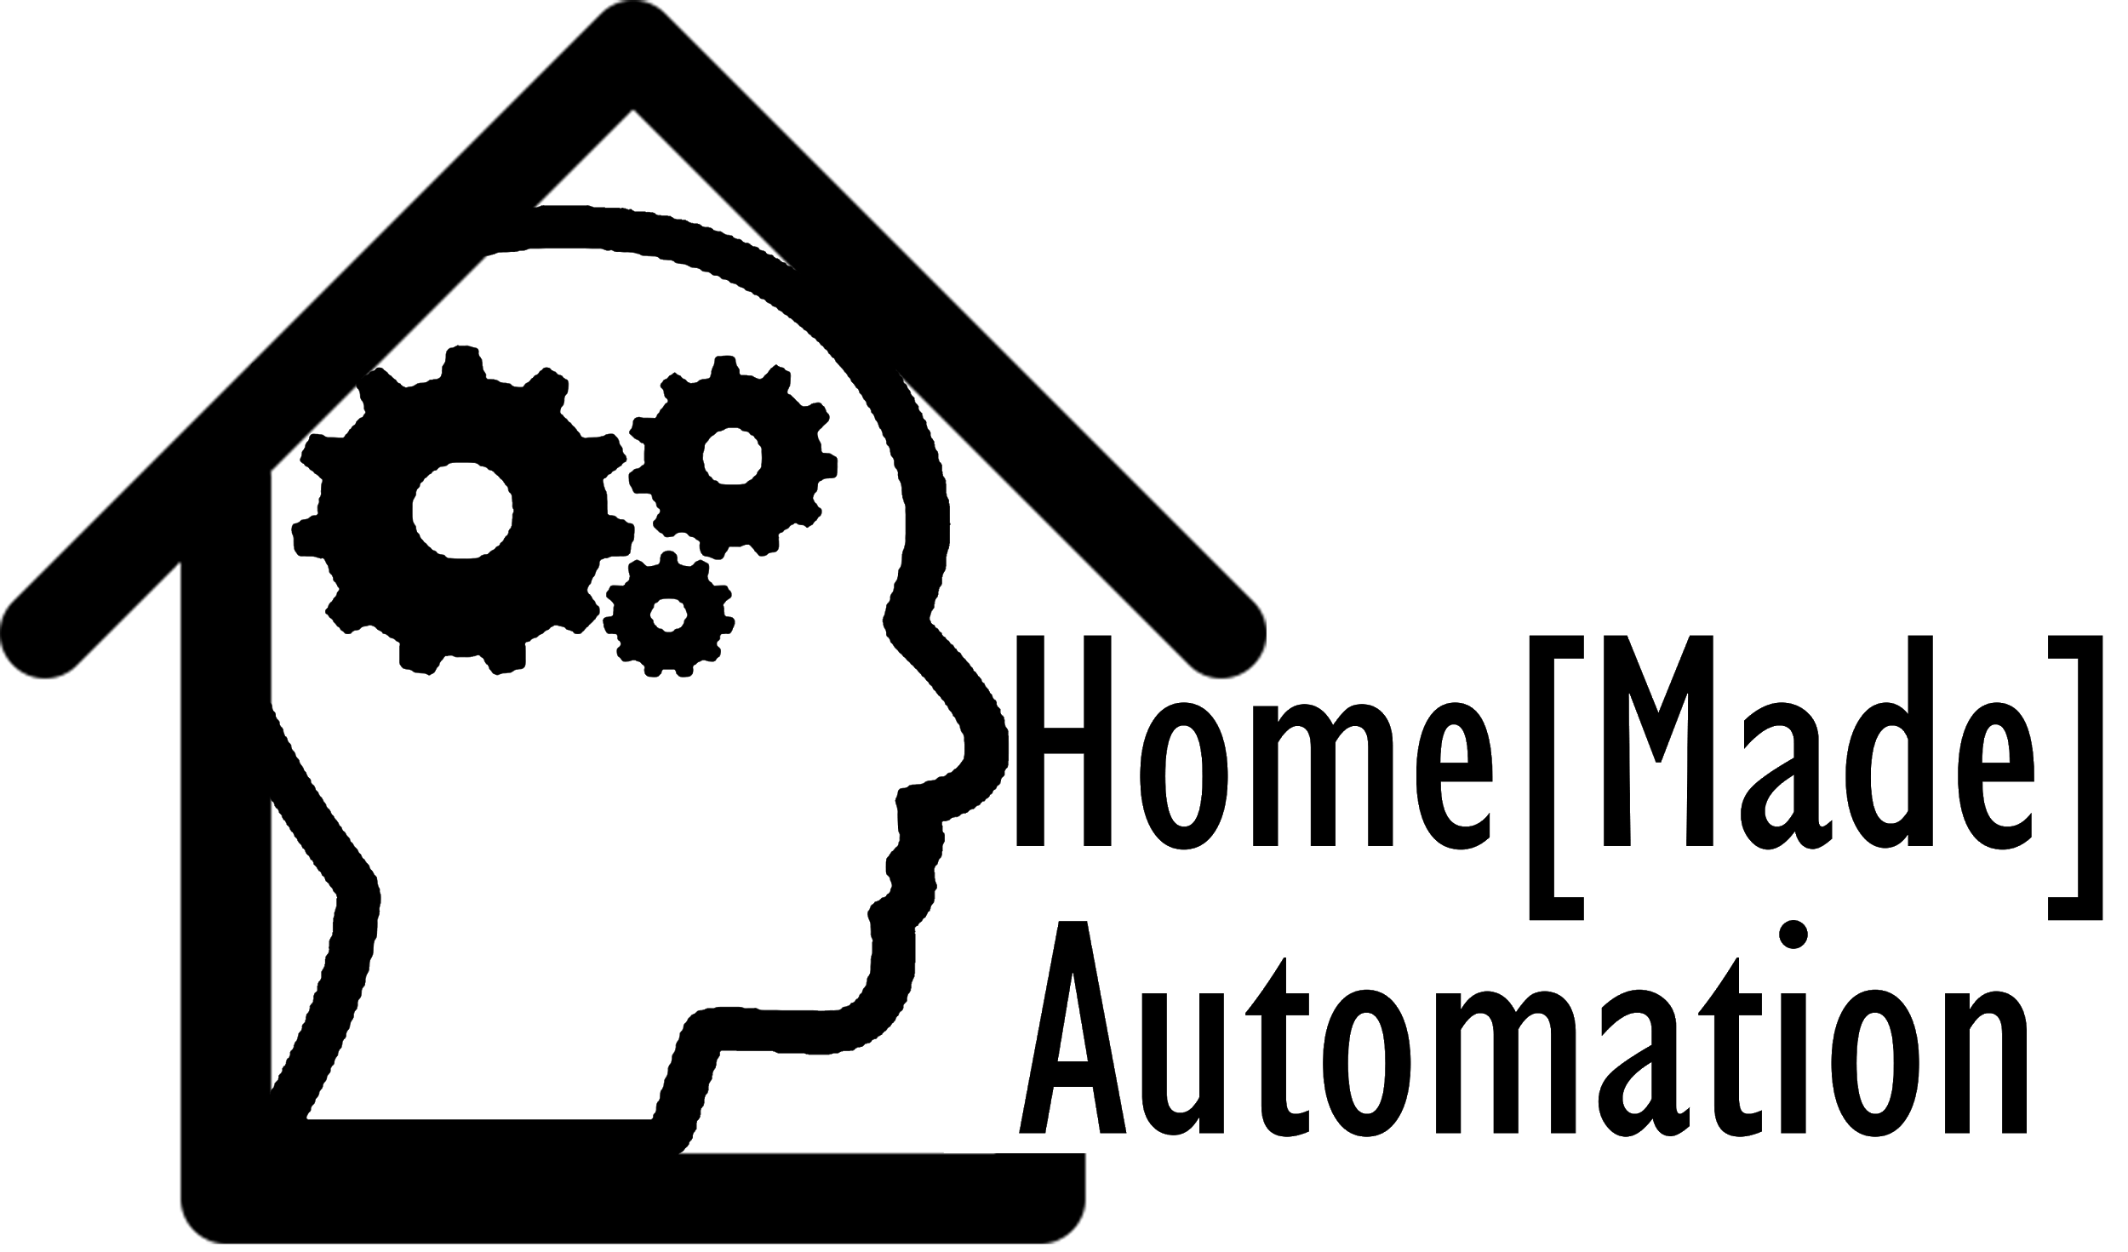
EPQ - Luke Price

Slide 2
Home Automation
Increased Convenience
Remote Control
Flexibility
Futuristic and Exciting
Why is it interesting?

Slide 3
Home Automation
Initially, remote controlled light using radio receiver
Controlled Via Web Application
Machine Learning Algorithm
How did the idea develop?

Slide 4
Home Automation
Create a fully automated Lighting system
Aim?

Slide 5
Home Automation
Light would turn off if the server didn't respond in time
DHCP IP Reservation
Difficulties?

Slide 6
The Research

Slide 7
How powerful does the controller need to be?
How will it know when to change state?
How will its state be controlled?
Where do the wires need to be connected to?
How do the GPIO pinouts work?
Is it safe to keep it running constantly?

Slide 8
The Plan

Slide 9
Materials
Raspberry Pi 3
GPIO Jumper Cables
MDF
8 Channel Relay

Slide 10
The Server

Slide 11



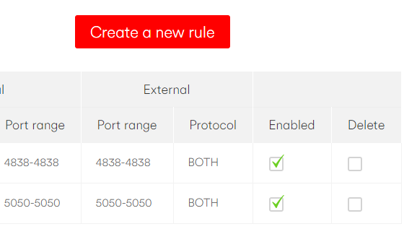
Setting Up The Server
WAMP
DHCP IP Reservation
Port Forward
Create Website

Slide 12
The Hardware

Slide 13


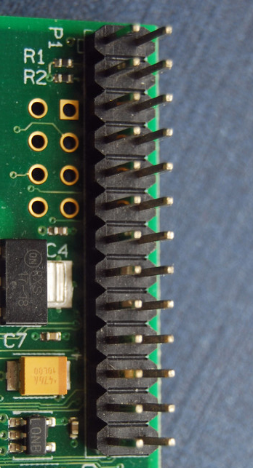
Raspberry Pi
Putty
Remote Updates And Debugging
GPIO
Python

Slide 14
Controlling

Slide 15
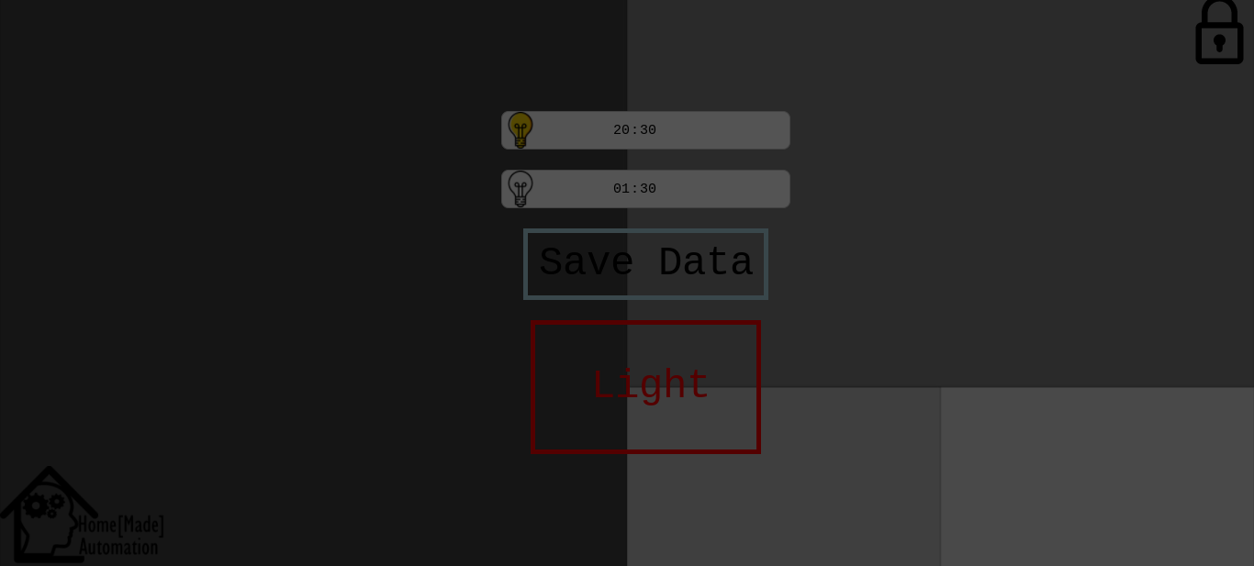
How can the state of the light be controlled?
Automated Timer / Toggle Page
Prediction Model

Slide 16
Complex Prediction Model

Slide 17
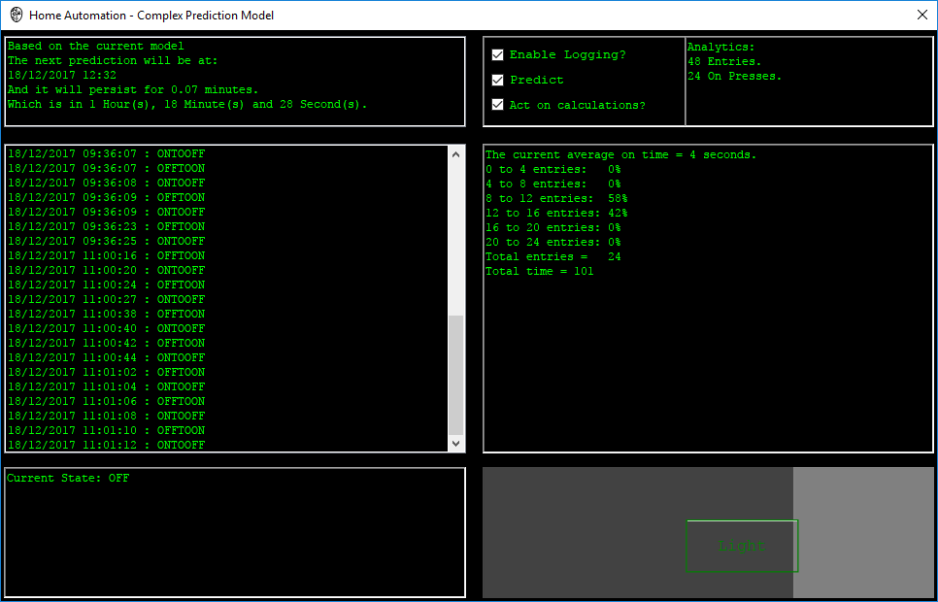
Full Autonomy
Prediction Algorithms
Using statistics to produce an output
Commonly used to predict crime location, type & time

Slide 18
Demo
Light Control Page
Current State Page

Slide 19
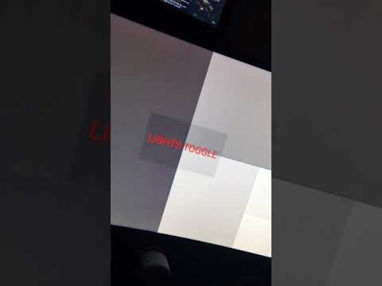
Video

Slide 20
Future

Slide 21
Future Of The Project
Future Of Home Automation
Adding more devices
Motor - Curtains
Power Strip
More intelligent prediction model
Public Concern / Hesitation
Market Share
Energy Saving
Reaction Time
Oil/Gas Leaks
Security
API Implementation
DarkSky
Adjusting to weather

Slide 22
Conclusion

Slide 23
Home Automation
Does it work?
Is it reliable?
Was it expensive?
What would I do differently?
Conclusion
Notes:
Proof of concept - i would do it for something more useful, for example a HR monitor

Slide 24
Thanks for listening.
:)

Slide 25
SKIP
Complex Prediction Model
Use of simple algorithms to produce a prediction based on trends
Deep Learning
Use of neural networks to form predictions, based on large data sets
Machine Learning
The way a program may take large data sets, learn from trends it encounters and improve the way it predicts
Artificial Intelligence
Broad term to describe how a computer may carry out a task in a smart way. Machine Learning and Deep Learning are subcategories of this
*neural networks: a model based on a biological neural network that increases the weight of its ‘synapses’ along a path that reaches a better result

